Slide 1
abstraction

Slide 2
abstraction
Is the process of taking away or removing characteristics from something in order to reduce it to a set of essential characteristics.
In object-oriented programming, abstraction is one of three central principles (along with encapsulation and inheritance).

Slide 3



abstraction
Through the process of abstraction, a programmer hides all but the relevant data about an object in order to reduce complexity and increase efficiency

Slide 4
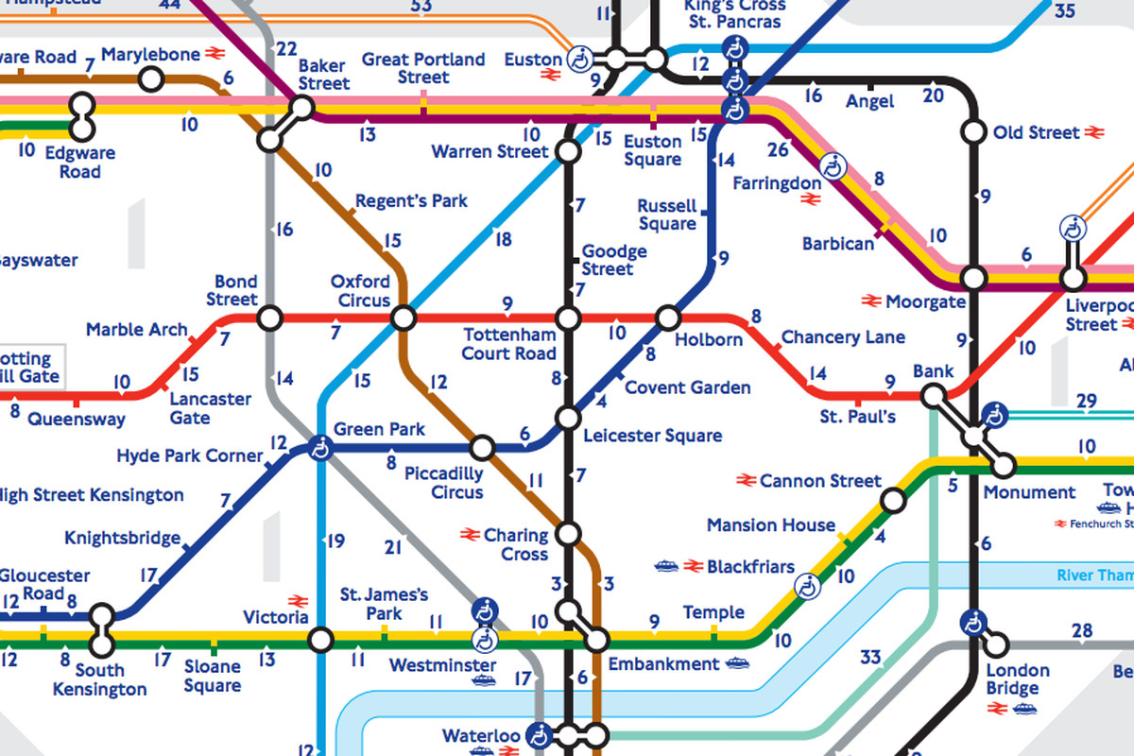
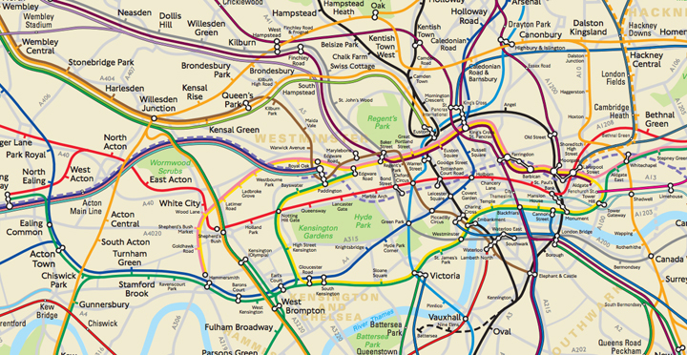

Slide 5
Abstraction: python
Data abstraction allows us to transform a complex data structure into one that’s simple and easy to use
The effect of this is that a program with a high level of code complexity can be transformed into one that looks close to English (let’s call it high-level code)
E.g. string
Float

Slide 6
Python floats
1/3 in base 10 is 0.333333333…..
Can’t represent it accurately
1/10 or 0.1 in binary is:
Python hides that complexity from you and shows 0.1

Slide 7

Further examples
When we use the TV remote to increase the volume. We don't know how pressing a key increases the volume of the TV. We only know to press the "+" button to increase the volume.
Pressing the “+” button on my soundbar remote also has the same effect. But internally something different is happening.

Slide 8
Data types (e.g. classes)
Public
Private
Protected

Slide 9
Class example
Consider a real life example, a car engine, which is made up of many parts like spark plug, valves, pistons, etc. No user use these parts directly, rather they just know how to use the parts which uses them.
This is what private methods are used for. It is used to hide the inner functionality of any class from the outside world.
Private methods are those methods that should neither be accessed outside the class.
In a Python class, to define a private method prefix the member name with double underscore “__”.

Slide 10
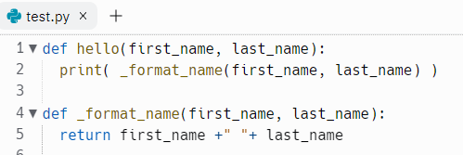
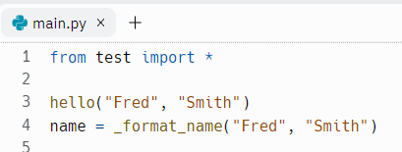
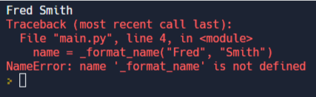
MODULE
Using an underscore means the function is private
OUR CODE
https://replit.com/@JohnGlazebrook/t-level-private-function#main.py

Slide 11
algorithms
https://www.ted.com/talks/kevin_slavin_how_algorithms_shape_our_world?language=en

